Slide 1
The Classroom in 2050
Do we dare go there!?

Slide 2
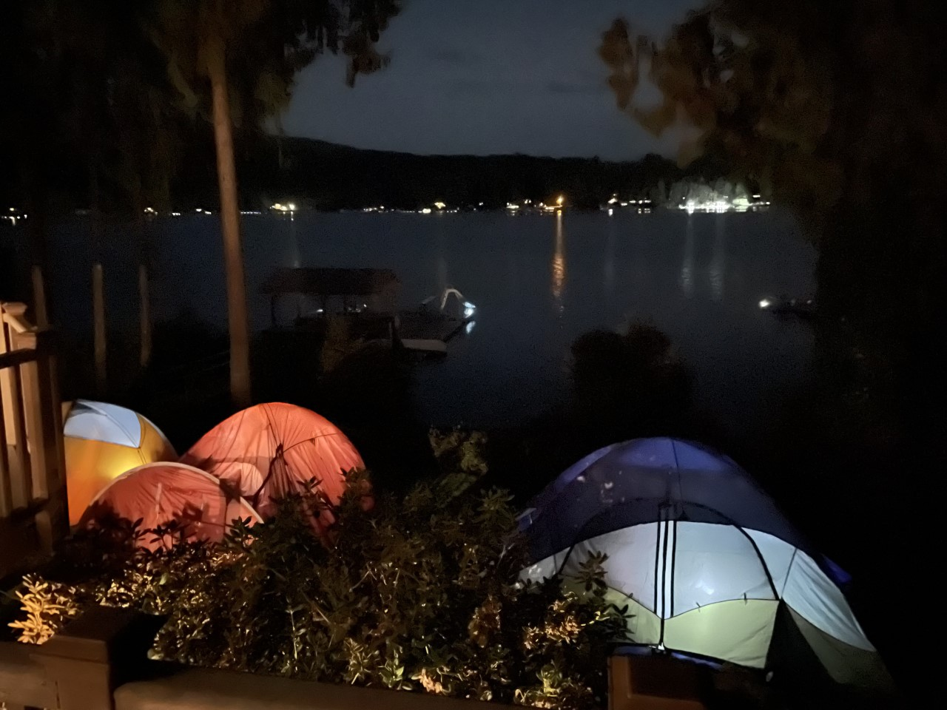
The classroom in 2050 will be inclusive, open, and outdoors.
Photo by Angela McLeish

Slide 3
Students will learn from teachers, teachers will learn from students. Cooperation, respect, valuing individuals will be key.
Photo by Reed Geiger on Unsplash

Slide 4
Play will be in the curriculum, in every grade.

Slide 5
One can always dream!

